Slide 1
Chapter#02 – Operating System Structures

Slide 2
Modes of Communication
Kernel Mode
In Kernel mode, the executing code has complete and unrestricted access to the underlying hardware. It can execute any CPU instruction and reference any memory address. Kernel mode is generally reserved for the lowest-level, most trusted functions of the operating system. Crashes in kernel mode are catastrophic; they will halt the entire PC.
User Mode
In User mode, the executing code has no ability to directly access hardware or reference memory. Code running in user mode must delegate to system APIs to access hardware or memory. Due to the protection afforded by this sort of isolation, crashes in user mode are always recoverable. Most of the code running on your computer will execute in user mode.

Slide 3
Advantages
Stability and Reliability
Simplified Debugging
Disadvantages
Performance Overhead
Limited Access
Advantages
Direct Hardware Access
Complete Control
Disadvantages
Increased Risk
Complex Debugging
Which of them for Kernal Mode?

Slide 4
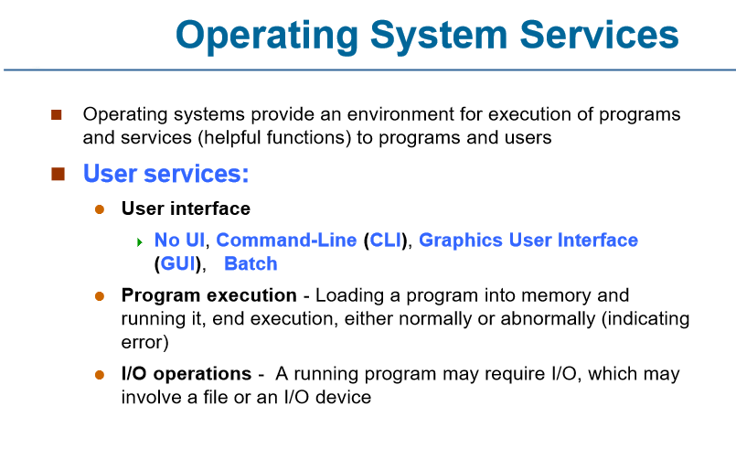

Slide 5
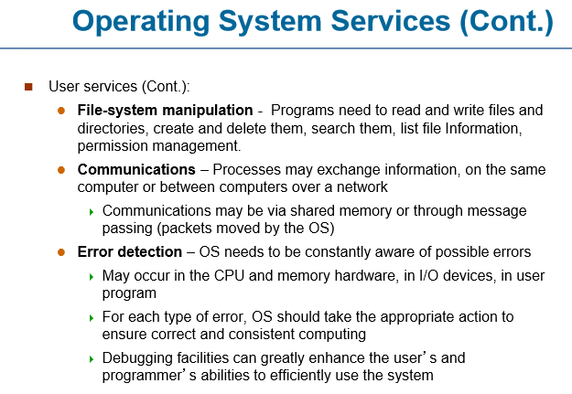

Slide 6
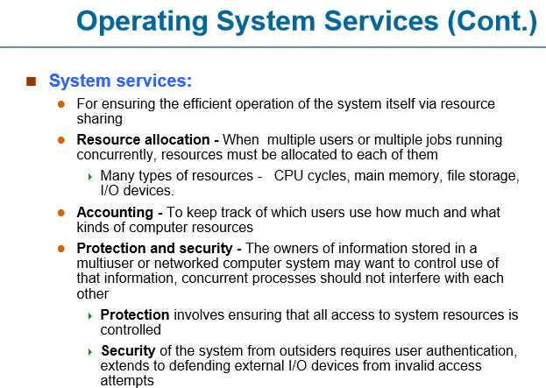

Slide 7
System Calls
Systems calls is a request made by the user program to the operating system in order to get any kind of services.
Typically written in a high-level language (C or C++)
System calls often use a special machine code instruction which causes the processor to change mode (e.g. to "supervisor mode" or "protected mode").
This allows the OS to perform restricted actions such as accessing hardware devices or the memory management unit.

Slide 8
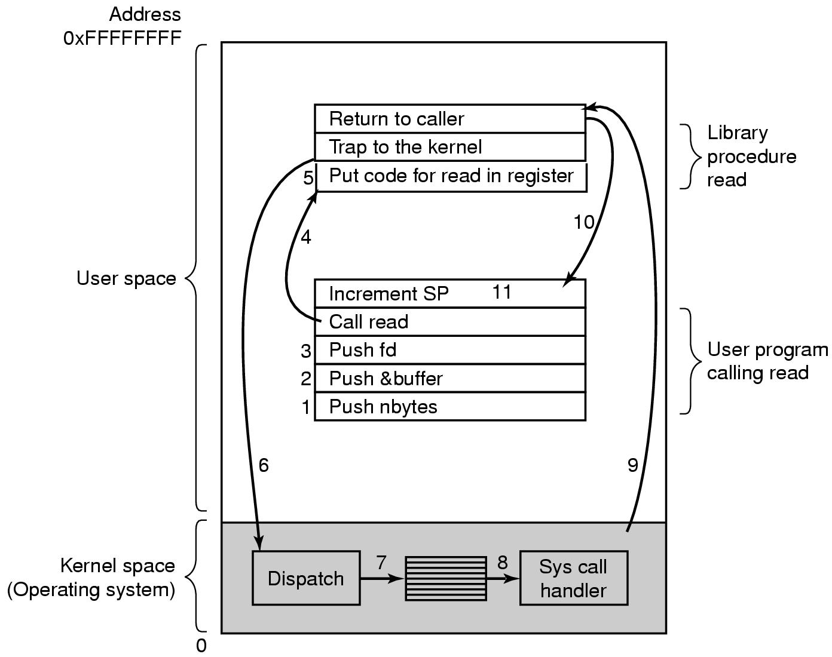
Steps in Making a System Call
fd: File descriptor from which to read.
buffer: Pointer to the buffer where the read data will be stored.
nbytes: Number of bytes to read.
There are 11 steps in making the system call
read (fd, buffer, nbytes)

Slide 9
Application Request: The user application determines that it needs to read data from a file descriptor.
Library Function Call: The application invokes the read function, which serves as an interface for the system call.
Parameter Preparation: The application prepares the parameters for the read system call:
fd: File descriptor from which to read.
buffer: Pointer to the buffer where the read data will be stored.
nbytes: Number of bytes to read.

Slide 10
System Call Wrapper: The read library function acts as a wrapper that may perform initial checks or preparations (like validating parameters).
Switch to Kernel Mode: The application uses a special instruction (e.g., syscall or int instruction in assembly) to switch the CPU from user mode to kernel mode.
System Call Handler: Control is passed to the operating system's kernel, where it identifies the requested service associated with the read call.
Execution of System Call: The kernel processes the read request, reading data from the file and performing checks (like verifying permissions).

Slide 11
Return to User Mode: After executing the read, the kernel prepares to return control to the user application, storing the number of bytes read in a register.
Restore Application State: The kernel sets the context back to the user mode of the calling process.
Accessing the Result: The application retrieves the result from the read function, which indicates how many bytes were read.
Error Handling: If an error occurs (e.g., invalid file descriptor, end of file), the error is returned in a standardized manner (often as a negative return value), and the application must handle this appropriately.

Slide 12
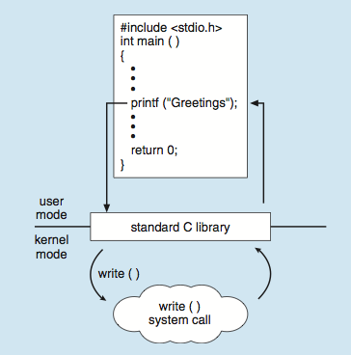
Standard C Library Example
C program invoking printf() library call, which calls write() system call

Slide 13
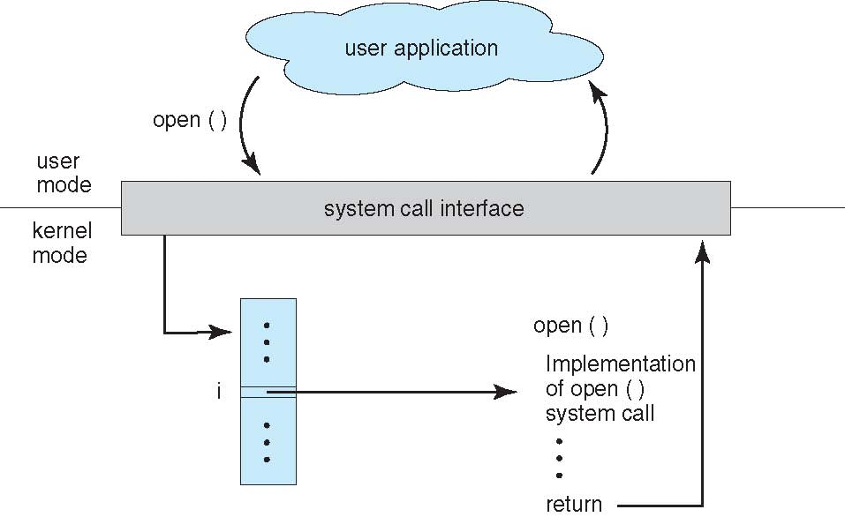
System Call – OS Relationship

Slide 14
Types of System Calls
Process control
create process, terminate process
end, abort
load, execute
wait for time
allocate and free memory
File management
create file, delete file
open, close file
read, write
Device management
request device, release device
read, write
logically attach or detach devices

Slide 15
Types of System Calls
Information maintenance
get time or date, set time or date
get system data, set system data
get and set process, file, or device attributes
Communications
create, delete communication connection
send, receive messages
transfer status information

Slide 16
1. Process Control
fork(): Fork - Creates a new process by duplicating the existing process.
exec(): Execute - Replaces the current process image with a new process image.
wait(): Wait - Waits for a child process to finish execution.
exit(): Exit - Terminates the calling process.
getpid(): Get Process ID - Returns the process ID of the calling process.
kill(): Kill - Sends a signal to a process, typically to terminate it.

Slide 17
2. File Management
open(): Open - Opens a file and returns a file descriptor.
close(): Close - Closes an open file descriptor.
read(): Read - Reads data from a file into a buffer.
write(): Write - Writes data from a buffer to a file.
lseek(): Length Seek - Repositions the file offset for a file descriptor.
stat(): Status - Retrieves information about a file (e.g., size, permissions).

Slide 18
3. Memory Management
mmap(): Memory Map - Maps files or devices into memory.
munmap(): Memory Unmap - Unmaps a mapped region of memory.
brk(): Break - Changes the location of the program's break, which defines the end of the process's data segment.
sbrk(): Set Break - Increments the program's data segment size.
4. Device Management
ioctl(): Input/Output Control - Manipulates the device parameters of special files.
read(): Read - Reads data from a device.
write(): Write - Writes data to a device

Slide 19
5. Information Management
getuid(): Get User ID - Retrieves the user ID of the calling process.
getgid(): Get Group ID - Retrieves the group ID of the calling process.
setuid(): Set User ID - Sets the user ID of the calling process.
setgid(): Set Group ID - Sets the group ID of the calling process.
gethostname(): Get Hostname - Retrieves the name of the host system.

Slide 20
6. Inter-Process Communication (IPC)
pipe(): Pipe - Creates a unidirectional data channel for inter-process communication.
shmget(): Shared Memory Get - Allocates a shared memory segment.
shmat(): Shared Memory Attach - Attaches a shared memory segment to the process's address space.
msgget(): Message Get - Creates a message queue.
semop(): Semaphore Operation - Performs operations on semaphores.
7. Networking
socket(): Socket - Creates a new socket.
bind(): Bind - Associates a socket with a specific address and port.
listen(): Listen - Marks a socket as a passive socket to accept incoming connections.
accept(): Accept - Accepts an incoming connection on a socket.
connect(): Connect - Initiates a connection to a server socket.

Slide 21
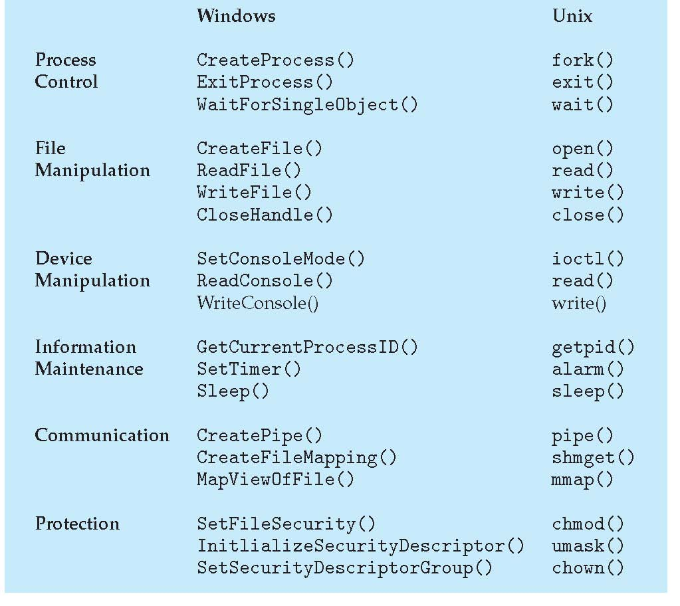
Examples of Windows and Unix System Calls

Slide 22
// Step 6: Read from file using read system call
printf("Reading from file...\n");
bytesRead = read(fd, buffer, BUFFER_SIZE - 1); // Read the file content
if (bytesRead == -1) {
perror("Error reading from file");
close(fd); // Ensure to close the file descriptor
exit(EXIT_FAILURE); // Exit if read fails
}
// Step 7: Null-terminate the buffer to make it a valid string
buffer[bytesRead] = '\0';
// Step 8: Output the content read from the file
printf("Content of the file:\n%s\n", buffer);
// Step 9: Close the file using the close system call
if (close(fd) == -1) {
perror("Error closing file");
exit(EXIT_FAILURE); // Exit if close fails
}
return 0; // Return success
}
#include <stdio.h> // For printf
#include <stdlib.h> // For exit
#include <fcntl.h> // For open
#include <unistd.h> // For read and close
#include <string.h> // For strlen
#define BUFFER_SIZE 1024
int main() {
const char *filename = "example.txt"; // File to be opened
int fd; // File descriptor
char buffer[BUFFER_SIZE]; // Buffer to hold file content
ssize_t bytesRead; // Number of bytes read
// Step 1: Application Request (not explicitly shown in code)
printf("Attempting to open the file: %s\n", filename);
// Step 2: Library Function Call
// Step 3: Parameter Preparation
fd = open(filename, O_RDONLY); // Open the file in read-only mode
// Step 4: Check for errors in opening the file
if (fd == -1) {
perror("Error opening file");
exit(EXIT_FAILURE); // Exit if file could not be opened
}
// Step 5: System Call Wrapper (open is a wrapper around the actual system call)

